Slide 1
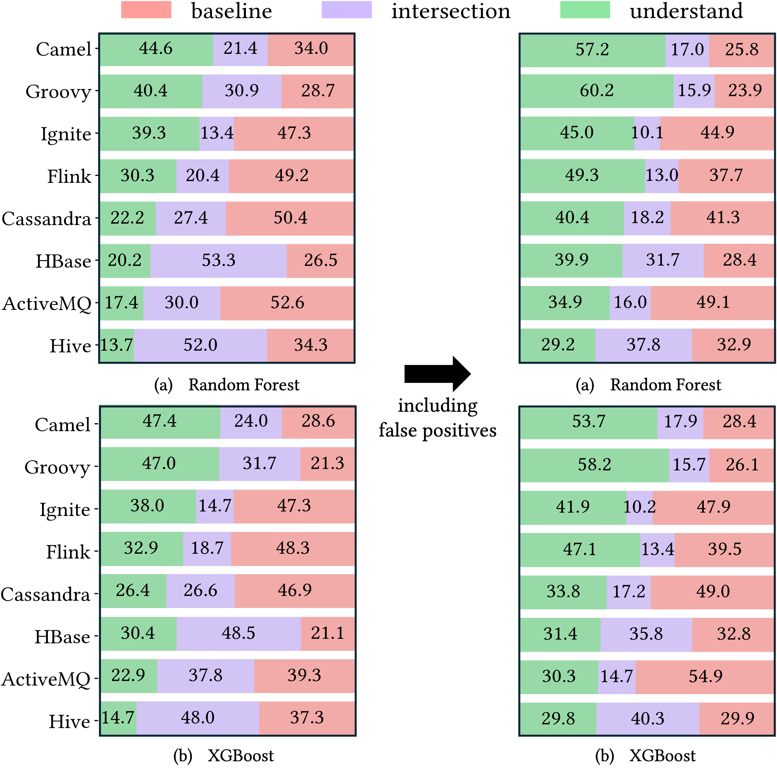
Q3-1
Set relationships after including false positives

Slide 2
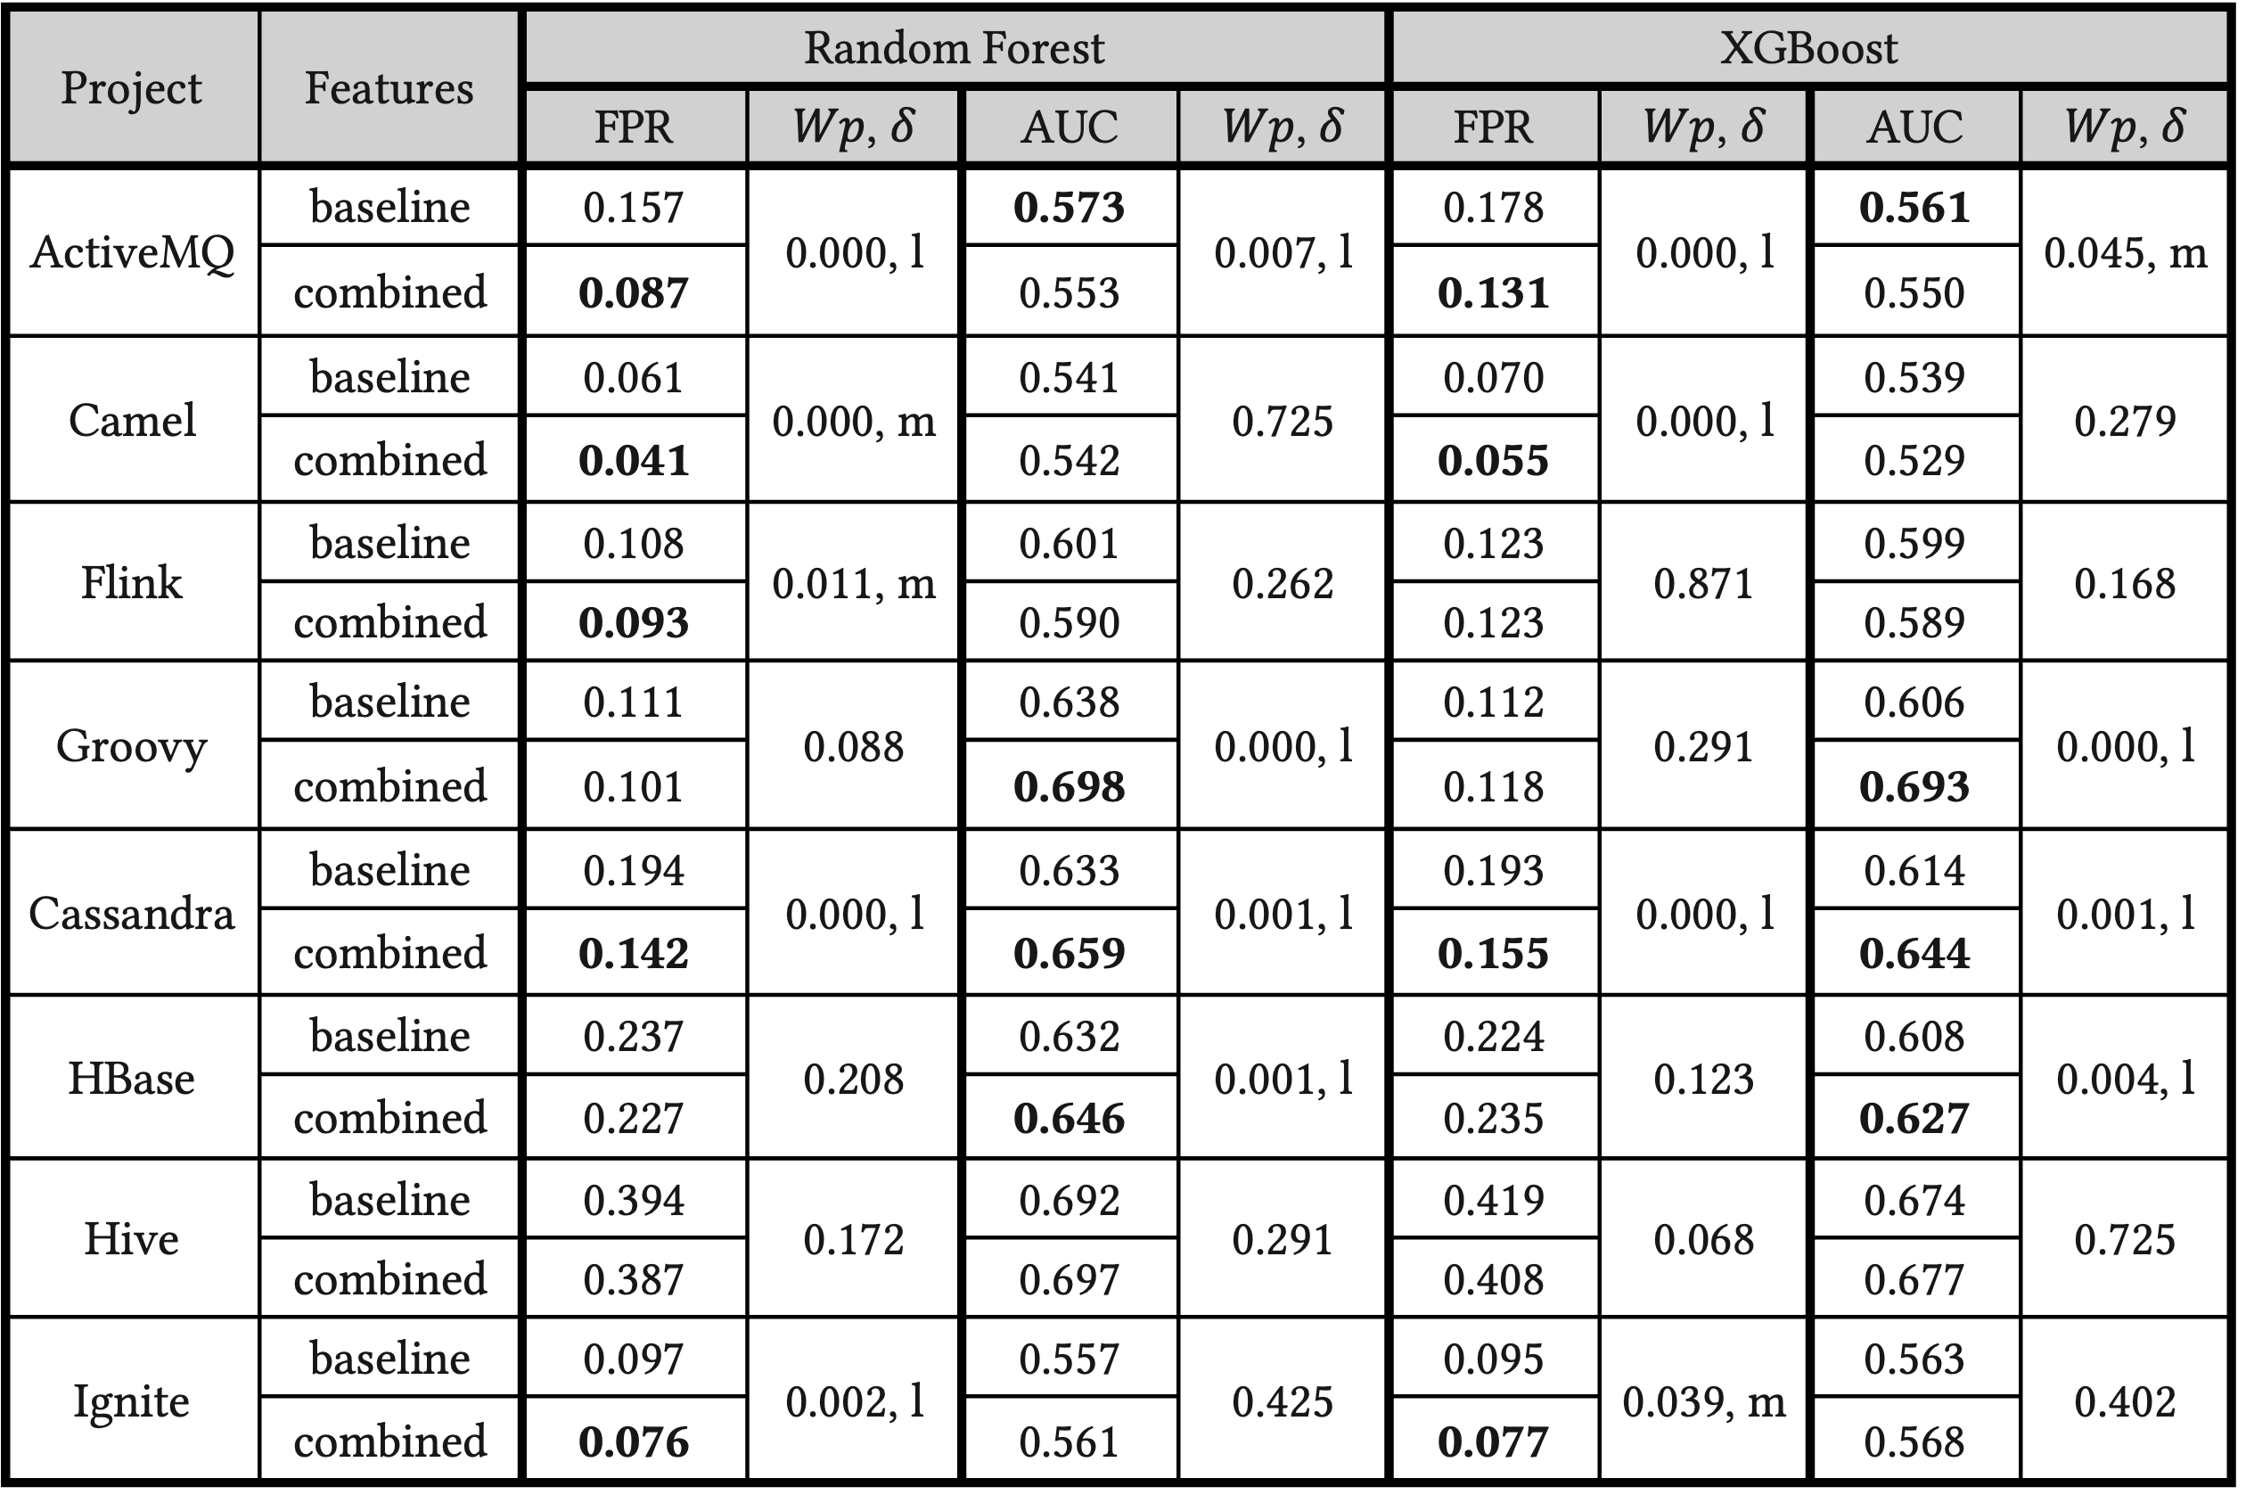
Q3-2
𝑊𝑝: p-values from Wilcoxon rank-sum test, 𝛿: Cliff’s delta effect size (l>m>s)
Performance comparision in terms of FPR and AUC

Slide 3
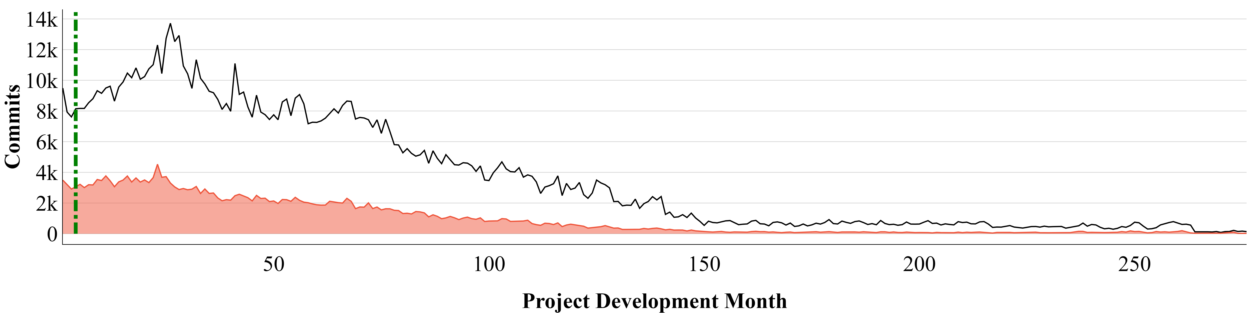
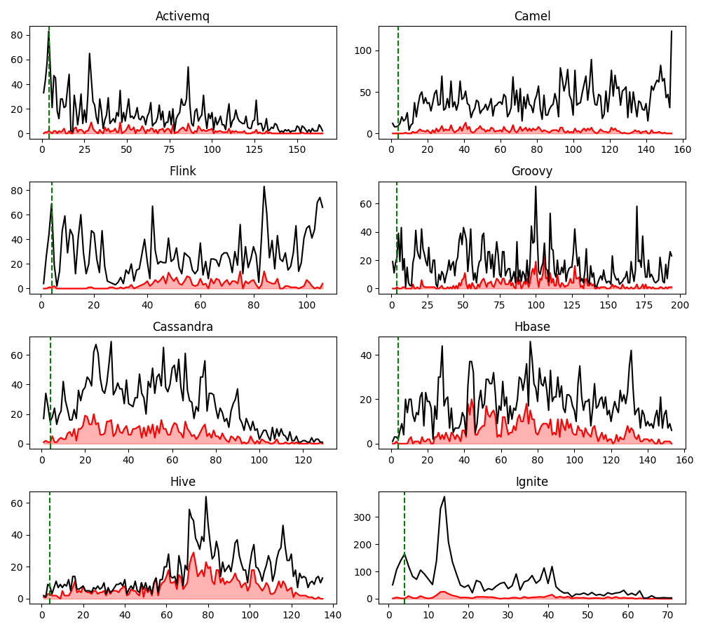
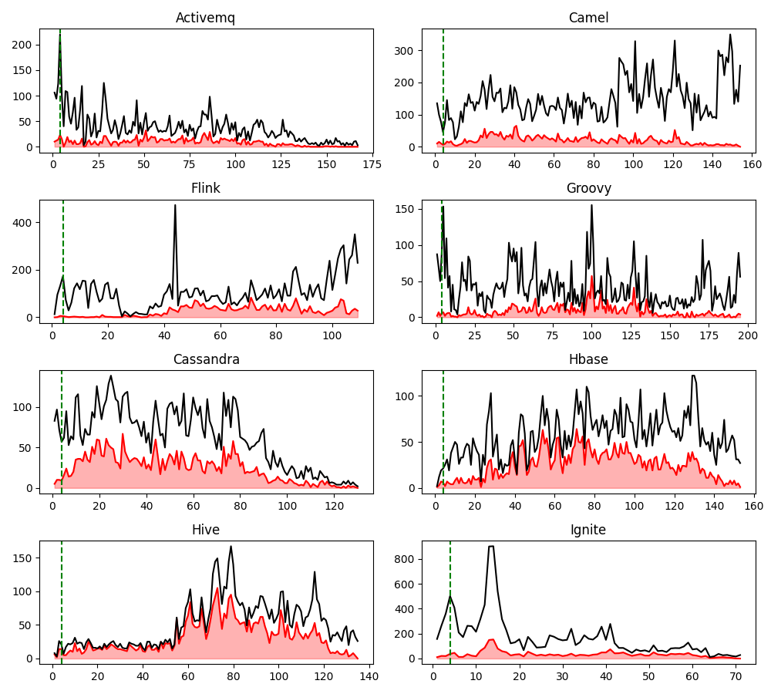
Q5
The distributions of defect-inducing commits over time in the reference
Our Dataset
ApacheJIT Dataset
Commits
Project Development Months
The distributions of defect-inducing commits over time in our study

